Slide 1
Computer Vision Deep Learning
YBIGTA Science Team 12기 최동민
Yonsei University Big Data YBIGTA

Slide 2
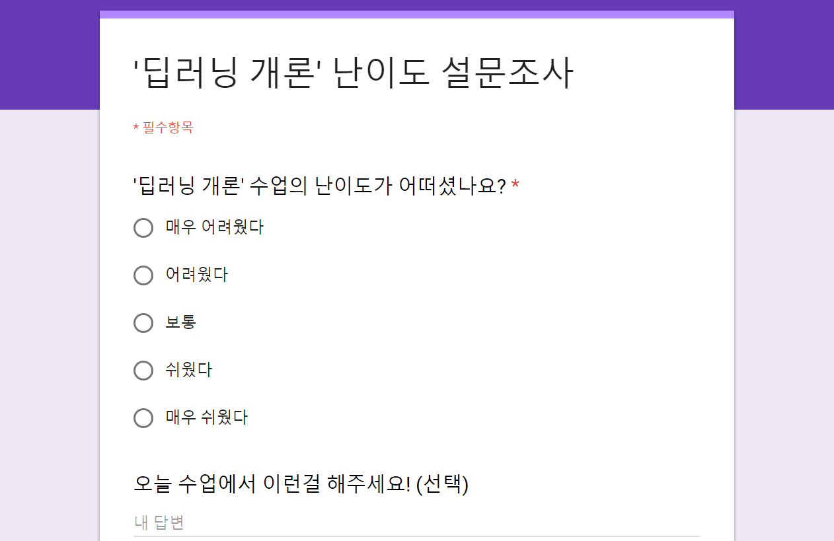
https://goo.gl/forms/h29bSwJthBklz3JG3
Yonsei University Big Data YBIGTA

Slide 3
Deep Learning
Yonsei University Big Data YBIGTA

Slide 4
Deep Learning이란?
딥러닝
Yonsei University Big Data YBIGTA

Slide 5
Deep Learning이란?
인공지능
딥러닝
Yonsei University Big Data YBIGTA

Slide 6
Deep Learning이란?
인공지능
딥러닝
머신러닝
Yonsei University Big Data YBIGTA

Slide 7
Deep Learning이란?
인공지능
인공신경망
딥러닝
머신러닝
Yonsei University Big Data YBIGTA

Slide 8
Deep Learning이란?
인공지능
인공신경망
딥러닝
머신러닝
Yonsei University Big Data YBIGTA

Slide 9
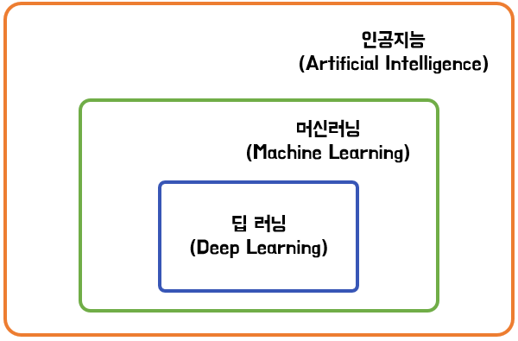
Deep Learning이란?
?
?
?
Yonsei University Big Data YBIGTA

Slide 10
Deep Learning이란?
?
?
Yonsei University Big Data YBIGTA

Slide 11
Deep Learning이란?
?
Yonsei University Big Data YBIGTA

Slide 12
Deep Learning이란?
Yonsei University Big Data YBIGTA

Slide 13
Deep Learning이란?
‘인공지능’이란?
Yonsei University Big Data YBIGTA

Slide 14
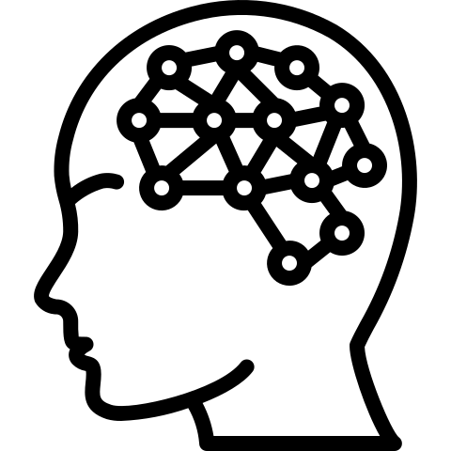
Deep Learning이란?
인공지능
Yonsei University Big Data YBIGTA

Slide 15
Deep Learning이란?
입력
인공지능
Yonsei University Big Data YBIGTA

Slide 16
Deep Learning이란?
입력
출력
인공지능
Yonsei University Big Data YBIGTA

Slide 17

Deep Learning이란?
인공지능
Yonsei University Big Data YBIGTA

Slide 18
Deep Learning이란?
고양이
인공지능
Yonsei University Big Data YBIGTA

Slide 19
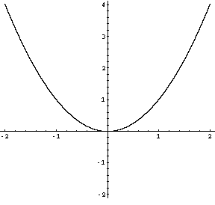
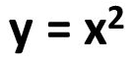
Deep Learning이란?
2
4
Yonsei University Big Data YBIGTA

Slide 20
Deep Learning이란?
입력
출력
인공지능
Yonsei University Big Data YBIGTA

Slide 21
Deep Learning이란?
입력
출력
인공지능
= 일종의 함수
Yonsei University Big Data YBIGTA

Slide 22
Deep Learning이란?
입력
출력
인공지능
= 일종의 복잡한 함수
Yonsei University Big Data YBIGTA

Slide 23
Deep Learning이란?
딥러닝 vs 머신러닝
Yonsei University Big Data YBIGTA

Slide 24
Deep Learning이란?
딥러닝 = 일종의 복잡한 함수
Yonsei University Big Data YBIGTA

Slide 25
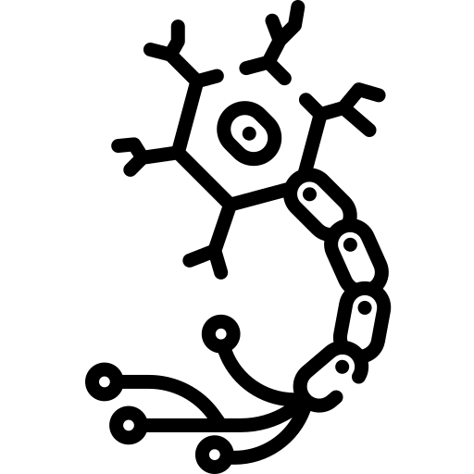
Deep Learning이란?
딥러닝 = 신경망을 본딴 함수
Yonsei University Big Data YBIGTA

Slide 26

Deep Learning이란?
뉴런 (신경세포)
Yonsei University Big Data YBIGTA

Slide 27
Deep Learning이란?
자극 (입력)
뉴런 (신경세포)
Yonsei University Big Data YBIGTA

Slide 28
Deep Learning이란?
역치 미만
0
자극 (입력)
뉴런 (신경세포)
1
역치 이상
Yonsei University Big Data YBIGTA

Slide 29

Deep Learning이란?
Yonsei University Big Data YBIGTA

Slide 30
Deep Learning이란?
노드 (Node)
Yonsei University Big Data YBIGTA

Slide 31
Deep Learning 용어
Yonsei University Big Data YBIGTA

Slide 32
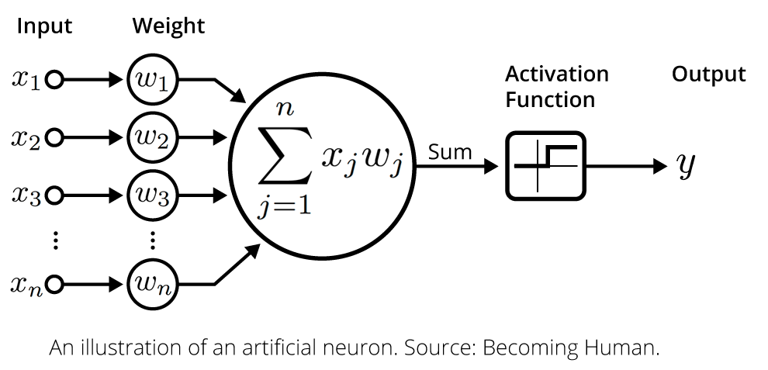
Deep Learning 용어
1. 가중치 (Weights)
역치
Yonsei University Big Data YBIGTA

Slide 33
Deep Learning 용어
1. 가중치 (Weights)
역치
학습시키는 대상
Yonsei University Big Data YBIGTA

Slide 34
Deep Learning 용어
2. 활성화 함수 (Activation Function)
딥러닝의 특징 중 하나 (비선형 함수)
Yonsei University Big Data YBIGTA

Slide 35


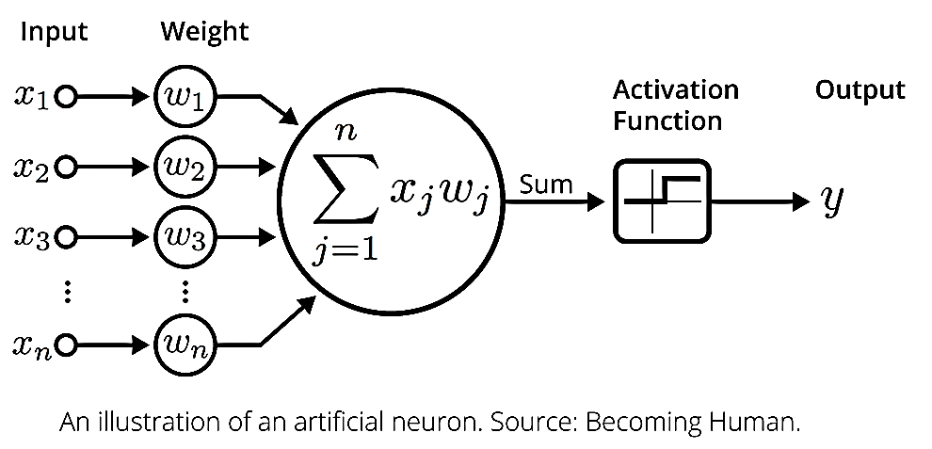
Deep Learning 용어
2. 활성화 함수 (Activation Function)
Sigmoid
딥러닝의 특징 중 하나 (비선형 함수)
Yonsei University Big Data YBIGTA

Slide 36

Deep Learning 용어
2. 활성화 함수 (Activation Function)
딥러닝의 특징 중 하나 (비선형 함수)
Yonsei University Big Data YBIGTA

Slide 37
Deep Learning 용어
3. 레이어 (Layer)
Yonsei University Big Data YBIGTA

Slide 38
Deep Learning 용어
4. 모델 (Model)
= Architecture = Network
Yonsei University Big Data YBIGTA

Slide 39
Deep Learning 용어
5. 손실 함수 (Loss Function)
Yonsei University Big Data YBIGTA

Slide 40
Deep Learning 용어
5. 손실 함수 (Loss Function)
: 신경망이 학습할 수 있도록 해주는 지표
or 학습 상태를 측정하는 지표
Yonsei University Big Data YBIGTA

Slide 41
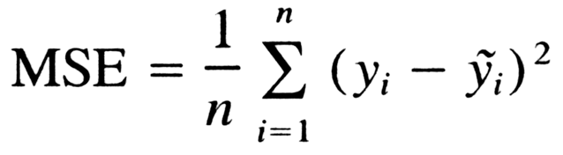
Deep Learning 용어
5. 손실 함수 (Loss Function)
: 신경망이 학습할 수 있도록 해주는 지표
or 학습 상태를 측정하는 지표
Mean Squared Error
True
Prediction
Yonsei University Big Data YBIGTA

Slide 42
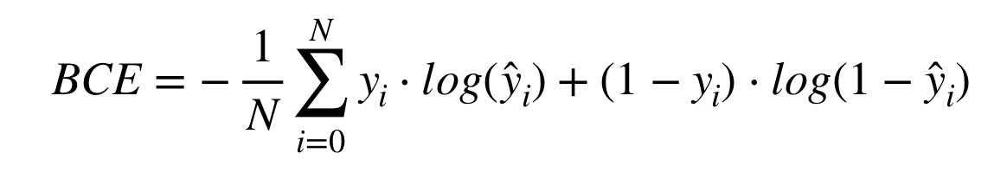
Deep Learning 용어
5. 손실 함수 (Loss Function)
: 신경망이 학습할 수 있도록 해주는 지표
or 학습 상태를 측정하는 지표
Binary Cross Entropy
Yonsei University Big Data YBIGTA

Slide 43
Deep Learning 용어
6. 역전파 (Back Propagation)
Yonsei University Big Data YBIGTA

Slide 44
Deep Learning 용어
6. 역전파 (Back Propagation)
: 출력을 통해 계산한 오차를 앞쪽 레이어로 전달하여 기울기(Gradient)를 계산하는 방법
Yonsei University Big Data YBIGTA

Slide 45
Deep Learning 용어
6. 역전파 (Back Propagation)
: 출력을 통해 계산한 오차를 앞쪽 레이어로 전달하여 기울기(Gradient)를 계산하는 방법
7. Optimizer
Yonsei University Big Data YBIGTA

Slide 46
Deep Learning 용어
6. 역전파 (Back Propagation)
: 출력을 통해 계산한 오차를 앞쪽 레이어로 전달하여 기울기(Gradient)를 계산하는 방법
7. Optimizer
: 기울기(Gradient)를 바탕으로 가중치(Weights)를 최적의 방향으로 업데이트해주는 역할
Yonsei University Big Data YBIGTA

Slide 47
Deep Learning 용어
Review
Yonsei University Big Data YBIGTA

Slide 48
Deep Learning 용어
Review
노드 (Node)
Yonsei University Big Data YBIGTA

Slide 49
Deep Learning 용어
Review
가중치 (Weights)
Yonsei University Big Data YBIGTA

Slide 50
Deep Learning 용어
Review
활성화 함수
(Activation function)
Yonsei University Big Data YBIGTA

Slide 51
Deep Learning 용어
Review
Yonsei University Big Data YBIGTA

Slide 52
Deep Learning 용어
Review
레이어 (Layer)
Yonsei University Big Data YBIGTA

Slide 53
Deep Learning 용어
Review
Yonsei University Big Data YBIGTA

Slide 54
Deep Learning 용어
Review
Model = Architecture = Network
Yonsei University Big Data YBIGTA

Slide 55
Deep Learning 용어
Review
Prediction
True
Yonsei University Big Data YBIGTA

Slide 56
Deep Learning 용어
Review
손실 함수 (Loss Function)
Prediction
True
Yonsei University Big Data YBIGTA

Slide 57
Deep Learning 용어
Review
Yonsei University Big Data YBIGTA

Slide 58
Deep Learning 용어
Review
역전파 (Back Propagation)
Yonsei University Big Data YBIGTA

Slide 59


Deep Learning 용어
Review
Yonsei University Big Data YBIGTA

Slide 60
Deep Learning 용어
Review
Optimization
Yonsei University Big Data YBIGTA

Slide 61
Computer Vision
Deep Learning
Yonsei University Big Data YBIGTA

Slide 62
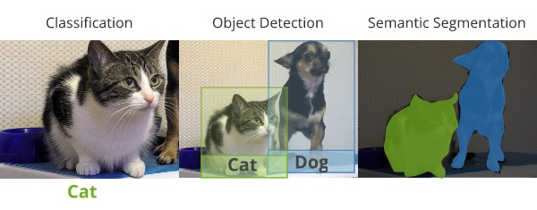
Computer Vision Deep Learning 예제
Yonsei University Big Data YBIGTA

Slide 63
Computer Vision Deep Learning 예제
Yonsei University Big Data YBIGTA

Slide 64
Computer Vision Deep Learning 예제
고양이
Yonsei University Big Data YBIGTA

Slide 65
Computer Vision Deep Learning 예제
고양이
Classification
Yonsei University Big Data YBIGTA

Slide 66
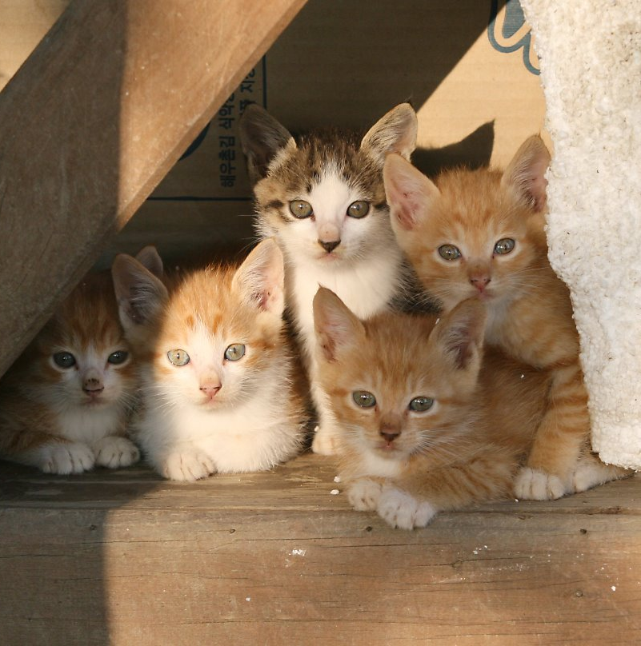
Computer Vision Deep Learning 예제
Yonsei University Big Data YBIGTA

Slide 67
Computer Vision Deep Learning 예제
Yonsei University Big Data YBIGTA

Slide 68
Computer Vision Deep Learning 예제
Object Detection
Yonsei University Big Data YBIGTA

Slide 69
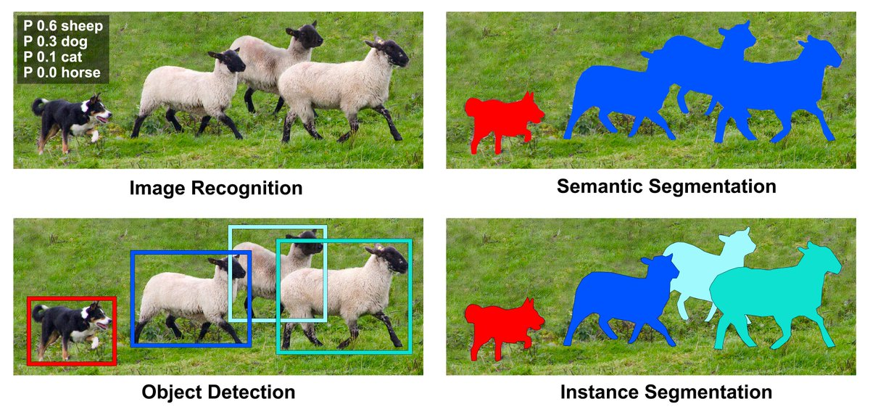
Computer Vision Deep Learning 예제
Yonsei University Big Data YBIGTA

Slide 70
Computer Vision Deep Learning 예제
Yonsei University Big Data YBIGTA

Slide 71
Computer Vision Deep Learning 예제
Segmentation
Yonsei University Big Data YBIGTA

Slide 72
Computer Vision Deep Learning 예제
Segmentation
Yonsei University Big Data YBIGTA

Slide 73
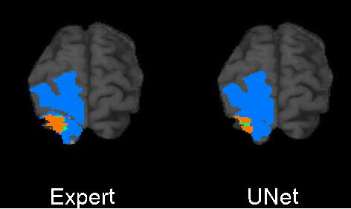
Computer Vision Deep Learning 예제
Brain Tumor Segmentation
Yonsei University Big Data YBIGTA

Slide 74
Computer Vision Deep Learning 예제
?
Yonsei University Big Data YBIGTA

Slide 75
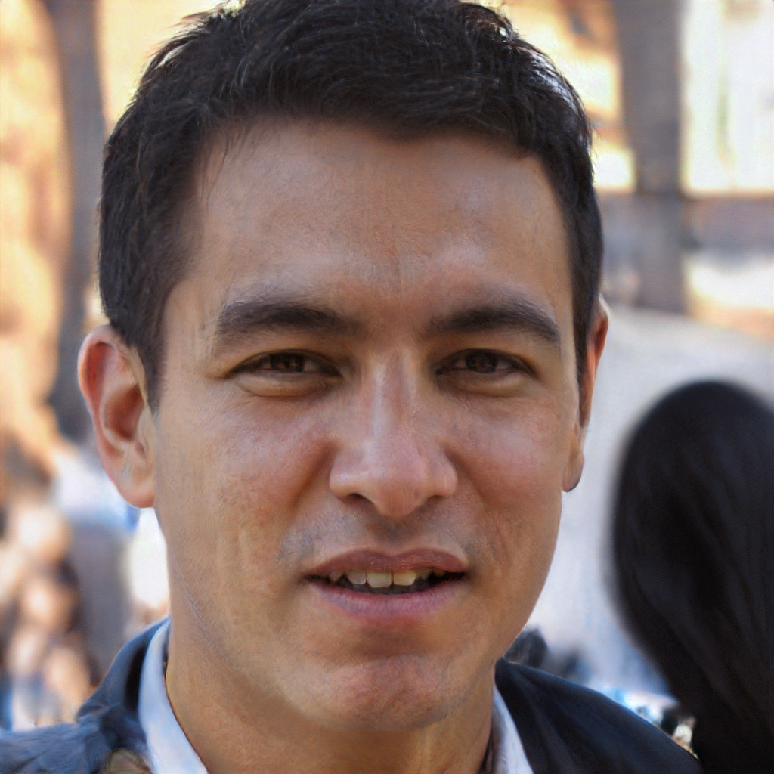
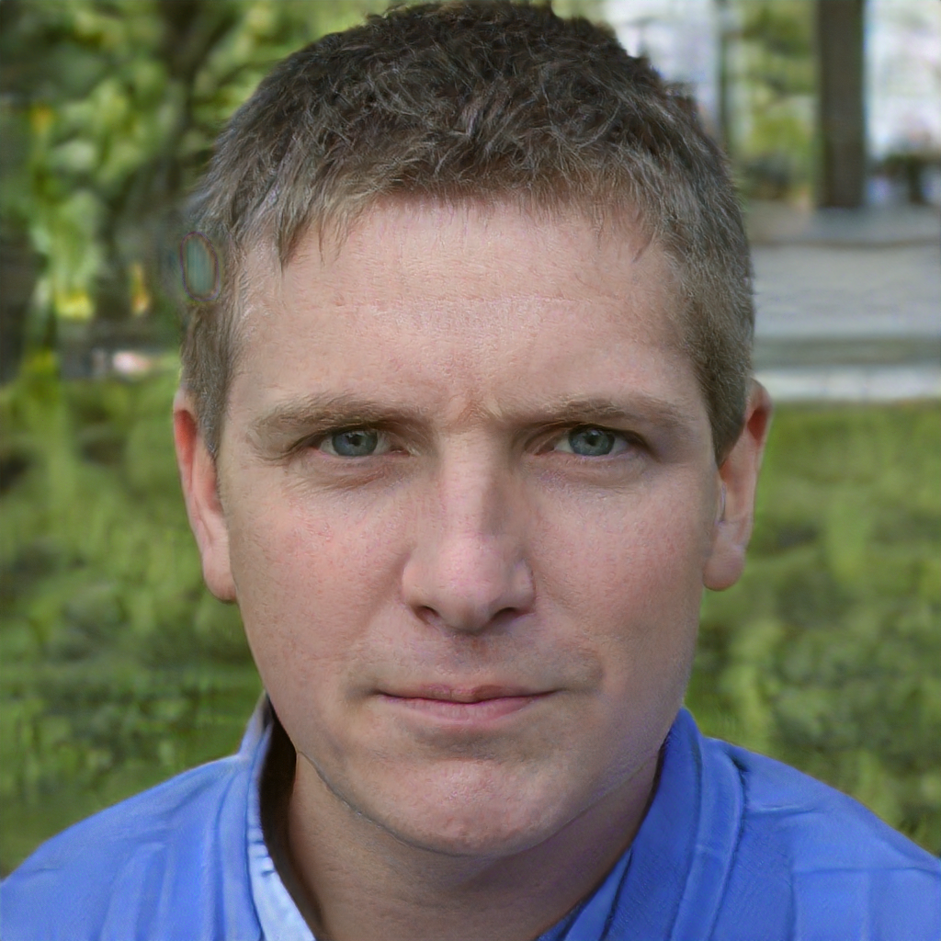
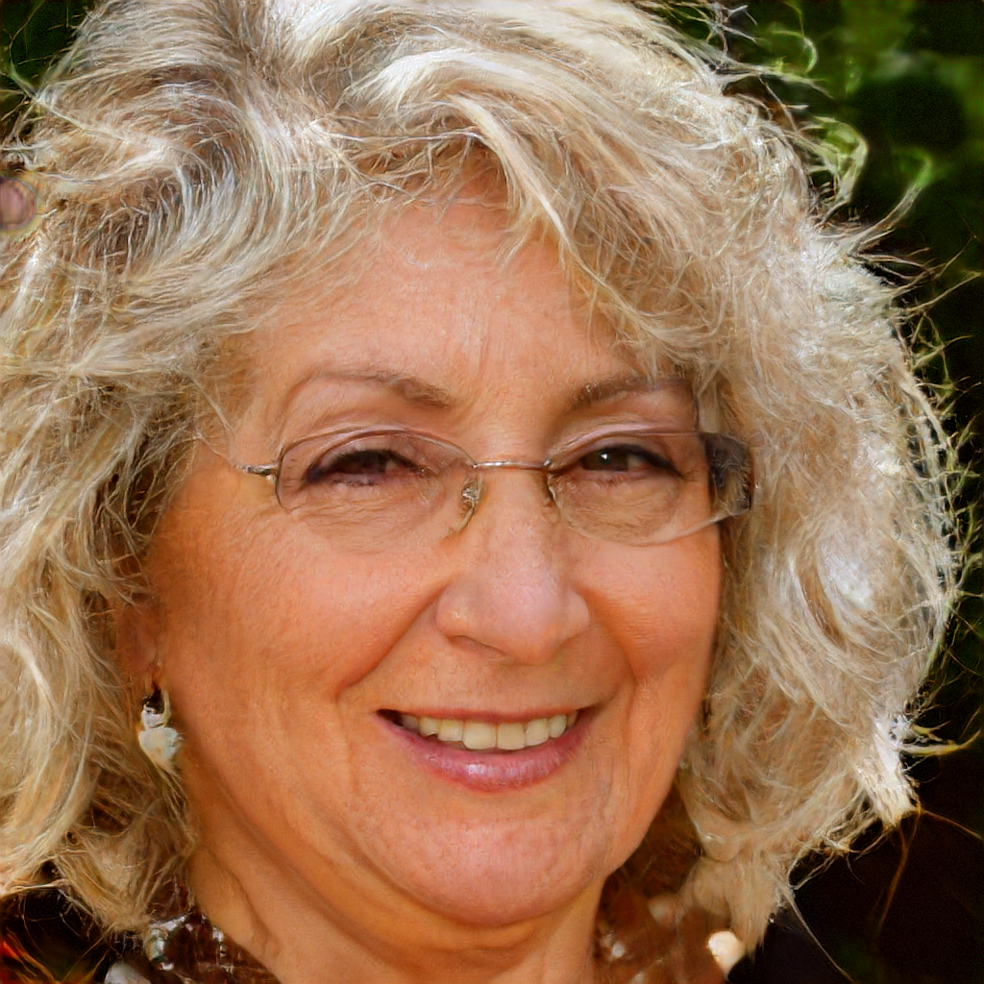
Computer Vision Deep Learning 예제
https://thispersondoesnotexist.com/
?
Yonsei University Big Data YBIGTA

Slide 76
Computer Vision Deep Learning 예제
https://thispersondoesnotexist.com/
?
Generation
Yonsei University Big Data YBIGTA

Slide 77
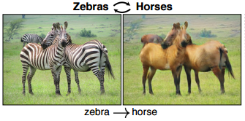
Computer Vision Deep Learning 예제
CycleGAN
Yonsei University Big Data YBIGTA

Slide 78
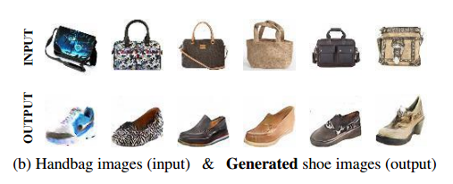
Computer Vision Deep Learning 예제
DiscoGAN
Yonsei University Big Data YBIGTA

Slide 79
Computer Vision Deep Learning 예제
앞선 모든 예시에서 사용된 모델
Yonsei University Big Data YBIGTA

Slide 80
Computer Vision Deep Learning 예제
앞선 모든 예시에서 사용된 모델
CNN (Convolutional Neural Network)
Yonsei University Big Data YBIGTA

Slide 81
CNN
Yonsei University Big Data YBIGTA

Slide 82
CNN (Convolutional Neural Network)
Convolutional Neural Network
Yonsei University Big Data YBIGTA

Slide 83
CNN (Convolutional Neural Network)
Convolutional Neural Network
신경망
Yonsei University Big Data YBIGTA

Slide 84
CNN (Convolutional Neural Network)
Convolutional Neural Network
합성곱
신경망
Yonsei University Big Data YBIGTA

Slide 85

CNN (Convolutional Neural Network)
사람
고양이 vs 강아지
Yonsei University Big Data YBIGTA

Slide 86
CNN (Convolutional Neural Network)
사람
고양이 vs 강아지
Yonsei University Big Data YBIGTA

Slide 87
CNN (Convolutional Neural Network)
사람
고양이 vs 강아지
Yonsei University Big Data YBIGTA

Slide 88
CNN (Convolutional Neural Network)
사람
고양이 vs 강아지
Yonsei University Big Data YBIGTA

Slide 89
CNN (Convolutional Neural Network)
딥러닝 모델
고양이 vs 강아지
Yonsei University Big Data YBIGTA

Slide 90
CNN (Convolutional Neural Network)
딥러닝 모델
고양이 vs 강아지
Yonsei University Big Data YBIGTA

Slide 91
CNN (Convolutional Neural Network)
딥러닝 모델
고양이 vs 강아지
Yonsei University Big Data YBIGTA

Slide 92
CNN (Convolutional Neural Network)
딥러닝 모델
고양이 vs 강아지
Yonsei University Big Data YBIGTA

Slide 93
CNN (Convolutional Neural Network)
딥러닝 모델
고양이 vs 강아지
Yonsei University Big Data YBIGTA

Slide 94
CNN (Convolutional Neural Network)
딥러닝 모델
고양이 vs 강아지
Yonsei University Big Data YBIGTA

Slide 95
CNN (Convolutional Neural Network)
Yonsei University Big Data YBIGTA

Slide 96
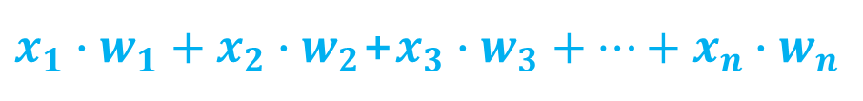
CNN (Convolutional Neural Network)
$x_{1}∙w_{1}+x_{2}∙w_{2}$+$x_{3}∙w_{3}+…+x_{n}∙w_{n}$
Yonsei University Big Data YBIGTA

Slide 97
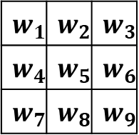
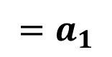
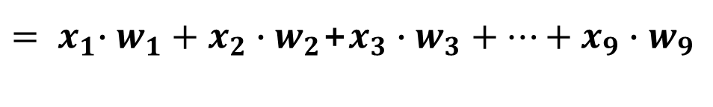
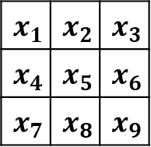
CNN (Convolutional Neural Network)
$$x_{1}$$ | $$x_{2}$$ | $$x_{3}$$
$$x_{4}$$ | $$x_{5}$$ | $$x_{6}$$
$$x_{7}$$ | $$x_{8}$$ | $$x_{9}$$
$$w_{1}$$ | $$w_{2}$$ | $$w_{3}$$
$$w_{4}$$ | $$w_{5}$$ | $$w_{6}$$
$$w_{7}$$ | $$w_{8}$$ | $$w_{9}$$
${= x}_{1}∙w_{1}+x_{2}∙w_{2}$+$x_{3}∙w_{3}+…+x_{9}∙w_{9}$
$${=a}_{1}$$
필터 (Filter)
Yonsei University Big Data YBIGTA

Slide 98
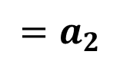
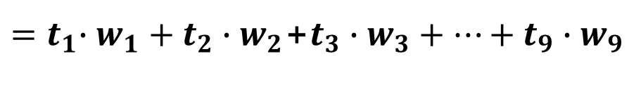
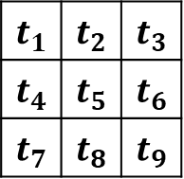
CNN (Convolutional Neural Network)
$$t_{1}$$ | $$t_{2}$$ | $$t_{3}$$
$$t_{4}$$ | $$t_{5}$$ | $$t_{6}$$
$$t_{7}$$ | $$t_{8}$$ | $$t_{9}$$
$$w_{1}$$ | $$w_{2}$$ | $$w_{3}$$
$$w_{4}$$ | $$w_{5}$$ | $$w_{6}$$
$$w_{7}$$ | $$w_{8}$$ | $$w_{9}$$
${=t}_{1}∙w_{1}+t_{2}∙w_{2}$+$t_{3}∙w_{3}+…+t_{9}∙w_{9}$
$${=a}_{2}$$
필터 (Filter)
Yonsei University Big Data YBIGTA

Slide 99
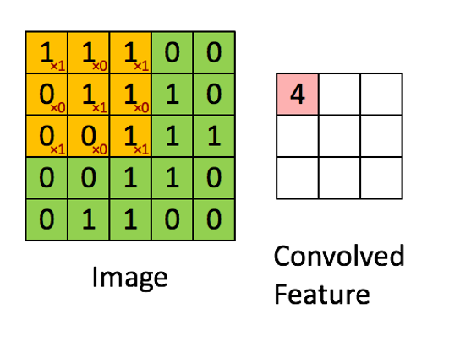
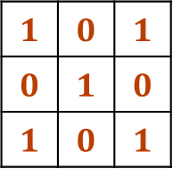
CNN (Convolutional Neural Network)
$$1$$ | $$0$$ | $$1$$
$$0$$ | $$1$$ | $$0$$
$$1$$ | $$0$$ | $$1$$
*
=
필터 (Filter)
Yonsei University Big Data YBIGTA

Slide 100
CNN (Convolutional Neural Network)
Yonsei University Big Data YBIGTA

Slide 101

CNN (Convolutional Neural Network)
Yonsei University Big Data YBIGTA

Slide 102

CNN (Convolutional Neural Network)
출력
입력
Yonsei University Big Data YBIGTA

Slide 103
CNN (Convolutional Neural Network)
입력과 출력이 이미지(벡터)
Yonsei University Big Data YBIGTA

Slide 104
CNN (Convolutional Neural Network)
입력과 출력이 이미지(벡터)
가중치로 구성된 필터를 이용
Yonsei University Big Data YBIGTA

Slide 105

CNN (Convolutional Neural Network)
Yonsei University Big Data YBIGTA

Slide 106
CNN (Convolutional Neural Network)
Yonsei University Big Data YBIGTA

Slide 107
CNN (Convolutional Neural Network)
Convolution – Pooling Layers
Yonsei University Big Data YBIGTA

Slide 108
CNN (Convolutional Neural Network)
Convolution – Pooling Layers
이미지의 정보(feature)를 얻어내는 과정
Yonsei University Big Data YBIGTA

Slide 109
CNN (Convolutional Neural Network)
Convolution – Pooling Layers
이미지의 정보(feature)를 얻어내는 과정
= 인코더 (Encoder) 부분
Yonsei University Big Data YBIGTA

Slide 110
CNN (Convolutional Neural Network)
Yonsei University Big Data YBIGTA

Slide 111
CNN (Convolutional Neural Network)
Fully-Connected Layer
Yonsei University Big Data YBIGTA

Slide 112
CNN (Convolutional Neural Network)
Fully-Connected Layer
Encoder에서 얻어낸 값들을 통해 최종 결과를 도출하는 과정
Yonsei University Big Data YBIGTA

Slide 113
CNN (Convolutional Neural Network)
Fully-Connected Layer
Encoder에서 얻어낸 값들을 통해 최종 결과를 도출하는 과정
= 단순히 선형 레이어를 쌓은 형태
Yonsei University Big Data YBIGTA

Slide 114
CNN (Convolutional Neural Network)
Fully-Connected Layer
Encoder에서 얻어낸 값들을 통해 최종 결과를 도출하는 과정
= 단순히 선형 레이어를 쌓은 형태
= MLP (Multi Layer Perceptron)
Yonsei University Big Data YBIGTA

Slide 115
CNN 용어
Yonsei University Big Data YBIGTA

Slide 116
CNN 용어
Yonsei University Big Data YBIGTA

Slide 117
CNN 용어
Yonsei University Big Data YBIGTA

Slide 118
CNN 용어
1. Pooling
Yonsei University Big Data YBIGTA

Slide 119
CNN 용어
1. Pooling
추출된 특징들 중 필요한 정보만 남도록 서브 샘플링(Sub-sampling)하는 과정
Yonsei University Big Data YBIGTA

Slide 120
CNN 용어
1. Pooling
추출된 특징들 중 필요한 정보만 남도록 서브 샘플링(Sub-sampling)하는 과정
Ex) Max-pooling, Average-pooling …
Yonsei University Big Data YBIGTA

Slide 121

CNN 용어
1. Pooling
추출된 특징들 중 필요한 정보만 남도록 서브 샘플링(Sub-sampling)하는 과정
Ex) Max-pooling, Average-pooling …
Yonsei University Big Data YBIGTA

Slide 122
CNN 용어
2. Stride
Yonsei University Big Data YBIGTA

Slide 123
CNN 용어
2. Stride
필터가 한번에 이동하는 pixel의 수
Yonsei University Big Data YBIGTA

Slide 124
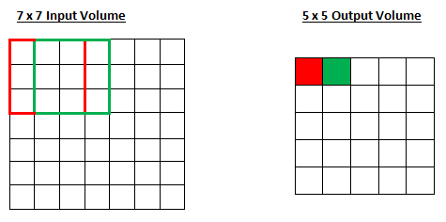
CNN 용어
2. Stride
필터가 한번에 이동하는 pixel의 수
Stride = 1
Yonsei University Big Data YBIGTA

Slide 125
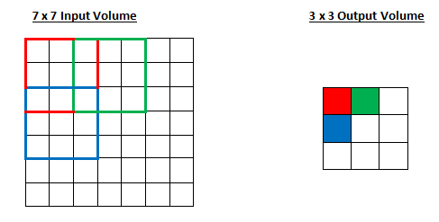
CNN 용어
2. Stride
필터가 한번에 이동하는 pixel의 수
Stride = 1
Stride = 2
Yonsei University Big Data YBIGTA

Slide 126
CNN 용어
2. Stride
필터가 한번에 이동하는 pixel의 수 = 출력 이미지의 크기를 결정하는 요소 중 하나
Stride = 1
Stride = 2
Yonsei University Big Data YBIGTA

Slide 127
CNN 용어
3. Padding
Yonsei University Big Data YBIGTA

Slide 128
CNN 용어
3. Padding
출력 이미지의 크기를 크게 해주려는 목적
Yonsei University Big Data YBIGTA

Slide 129
CNN 용어
3. Padding
출력 이미지의 크기를 크게 해주려는 목적
Ex) Zero-padding, Replication-padding, Reflection-padding
Yonsei University Big Data YBIGTA

Slide 130
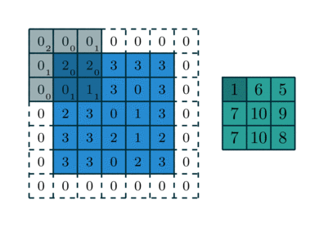
CNN 용어
3. Padding
출력 이미지의 크기를 크게 해주려는 목적
Ex) Zero-padding, Replication-padding, Reflection-padding
Zero-padding (Filter size = 3, Stride = 2)
Yonsei University Big Data YBIGTA

Slide 131
GAN (Generative Adversarial Network)
Yonsei University Big Data YBIGTA

Slide 132
GAN이란?
Generative Adversarial Network
Yonsei University Big Data YBIGTA

Slide 133
GAN이란?
Generative Adversarial Network
생성
Yonsei University Big Data YBIGTA

Slide 134
GAN이란?
Generative Adversarial Network
생성
적대하는
Yonsei University Big Data YBIGTA

Slide 135
GAN이란?
Generative Adversarial Network
생성
적대하는
네트워크
Yonsei University Big Data YBIGTA

Slide 136
GAN이란?
Generative Adversarial Network
생성
적대하는
네트워크
Yonsei University Big Data YBIGTA

Slide 137
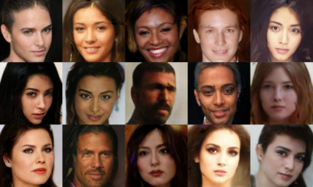
GAN이란? – Generative
Generated Faces
Yonsei University Big Data YBIGTA

Slide 138
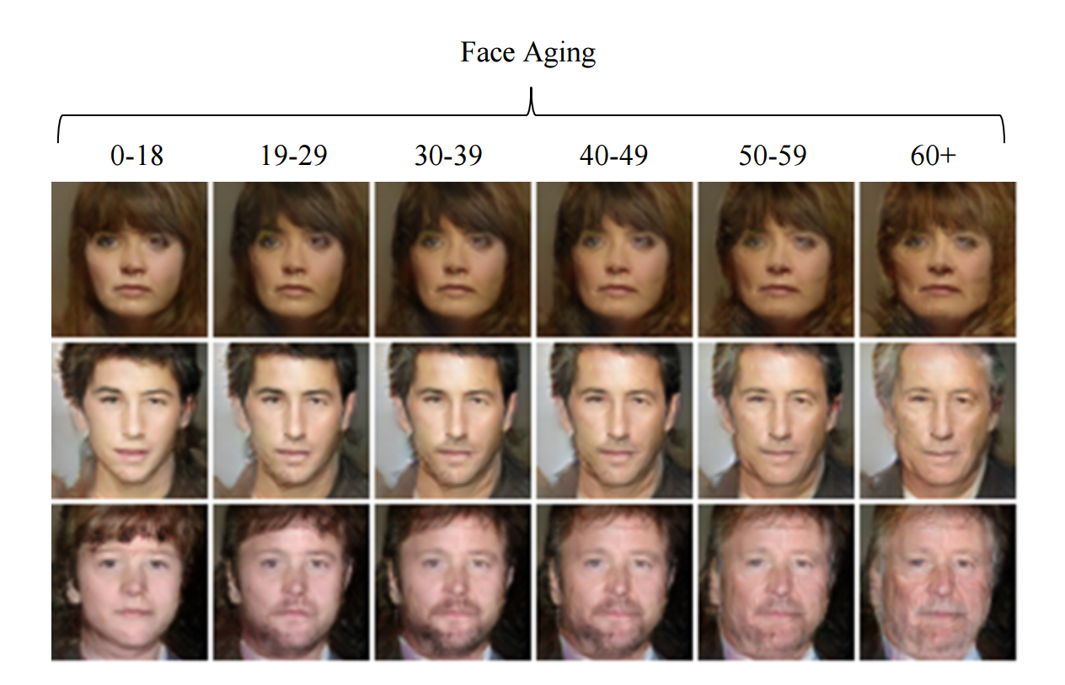
GAN이란? – Generative
Yonsei University Big Data YBIGTA

Slide 139
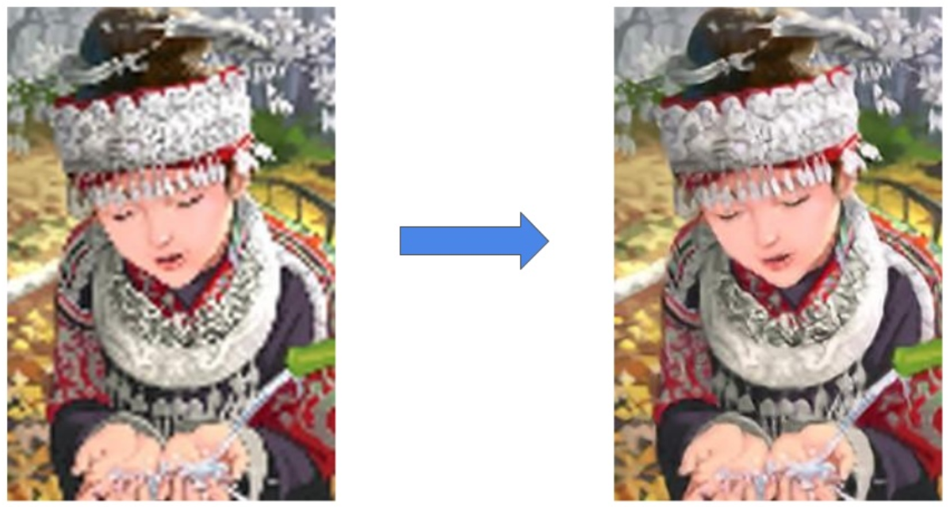
GAN이란? – Generative
Super Resolution (SRGAN)
Yonsei University Big Data YBIGTA

Slide 140
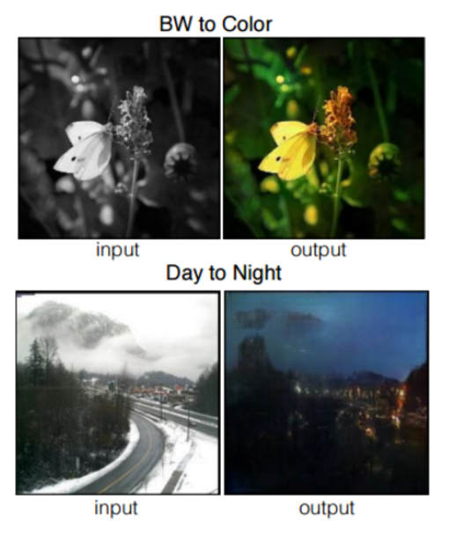
GAN이란? – Generative
Yonsei University Big Data YBIGTA

Slide 141
GAN의 직관적 이해
Yonsei University Big Data YBIGTA

Slide 142
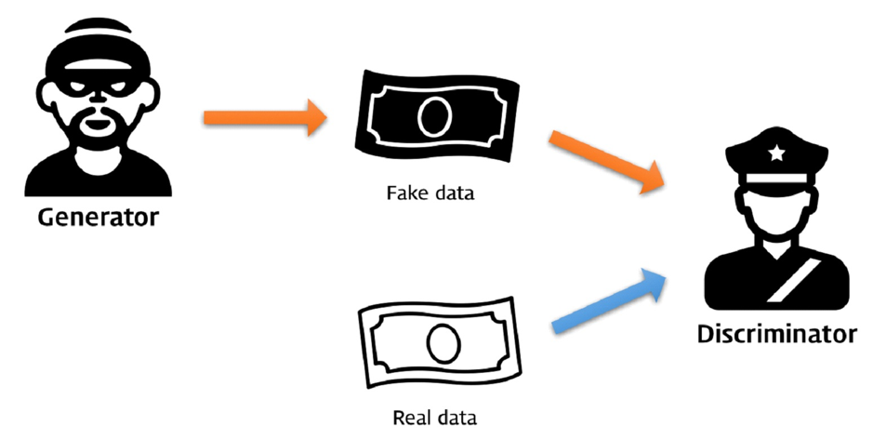
GAN의 직관적 이해
Yonsei University Big Data YBIGTA

Slide 143
GAN의 직관적 이해
Generative
Yonsei University Big Data YBIGTA

Slide 144
GAN의 직관적 이해
Adversarial
Yonsei University Big Data YBIGTA

Slide 145

더 자세한 내용은
사이언스팀에서 !!
https://www.facebook.com/ybigtascience/
Yonsei University Big Data YBIGTA

Slide 146
Q&A
Yonsei University Big Data YBIGTA

Slide 147
Thank You

